Slide 1

NBA All-Star by Smashmouth
By William Parlan and Aaron Miller

Slide 2
Introduction
A brief description of your personal motivation for the project
A brief description of your dataset including what type of data it contains, how many attributes, how many instances, what the class labels are, and any additional challenges (e.g., missing values, noise, continuous attributes, etc.).

Slide 3

Exploratory Data Analysis

Slide 4
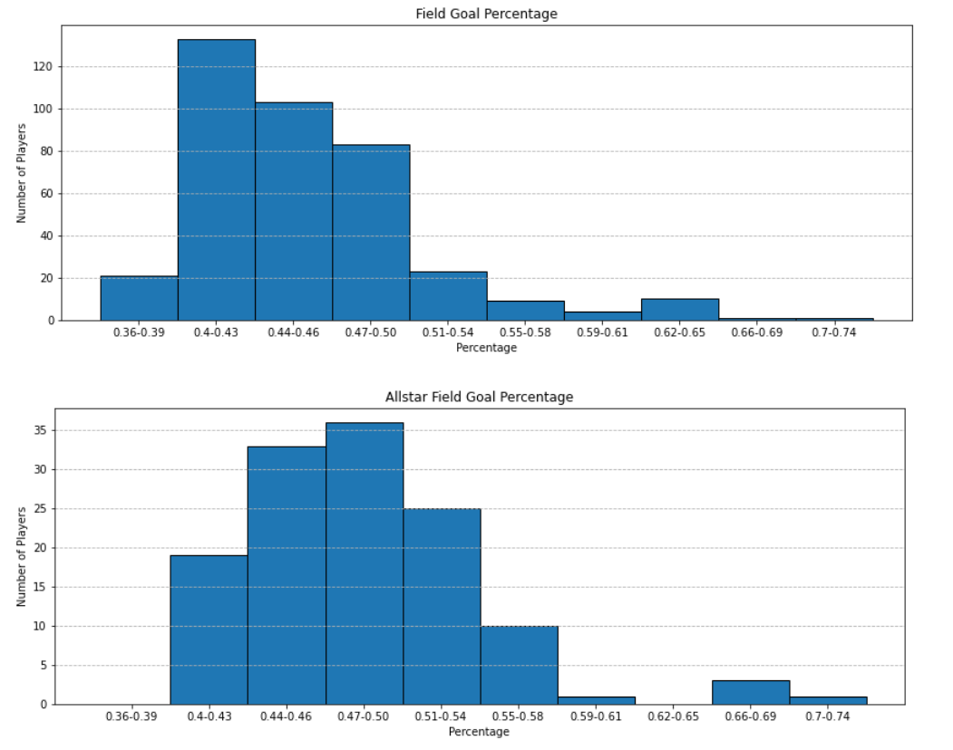
Trait 1: Field Goal Percentage
Allstar data is less heavily left skewed than other players.

Slide 5
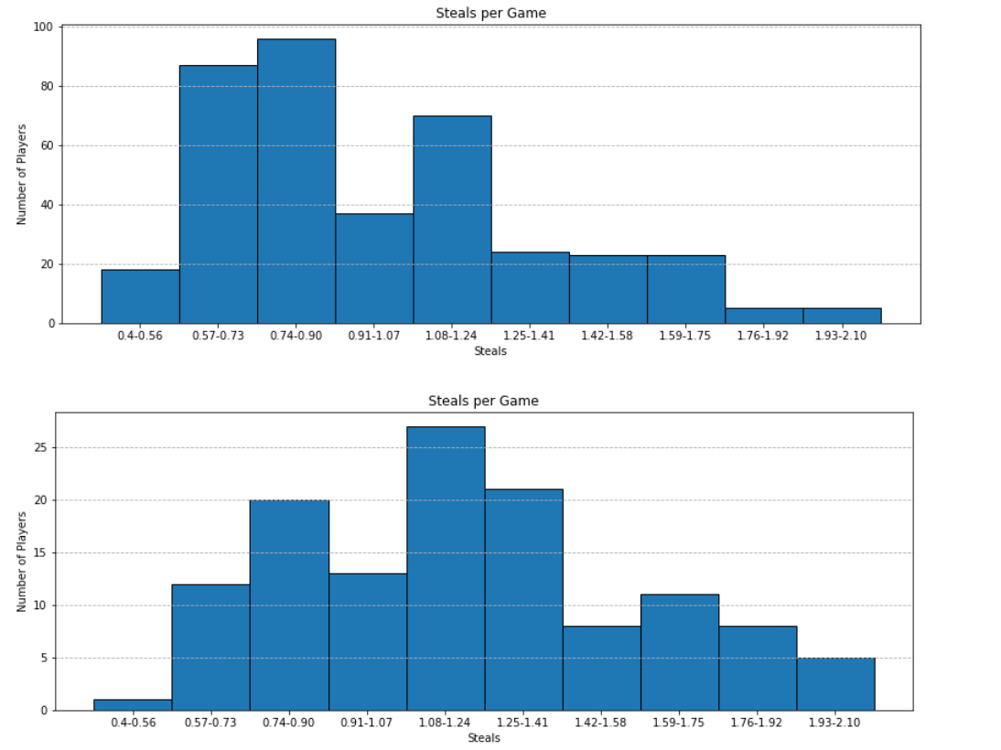
Trait 2: Steals per Game
Once again, allstar data is less heavily left skewed than other players.
Allstar data is pseudo-normal.

Slide 6
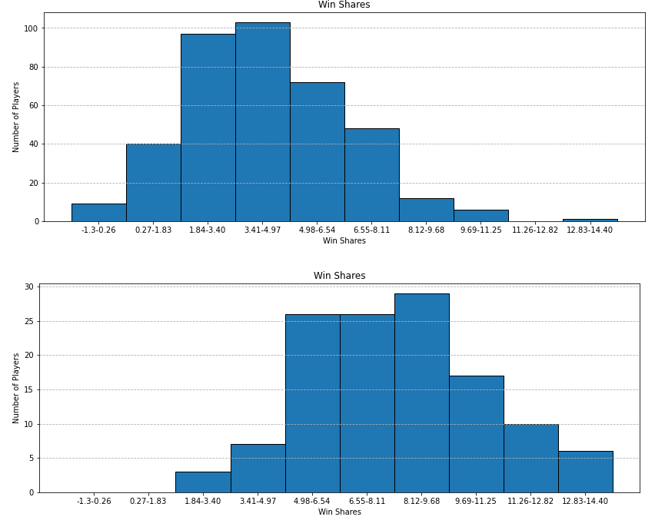
Trait 3: Win Shares
An estimate of the number of wins contributed by a player
Allstar is significantly right shifted

Slide 7

Classification Results

Slide 8
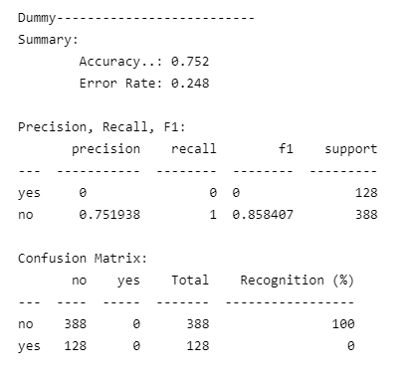
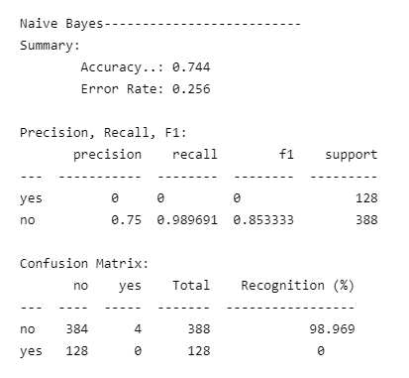
Using Only Effective Field Goal Percentage

Slide 9
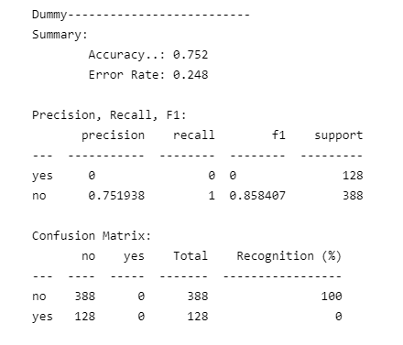
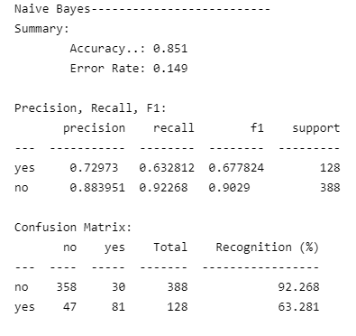
Using rebounds, assists, steals, blocks, and points per game

Slide 10
Conclusion
A brief description of any ideas you have on how to improve classification for the dataset or any challenges in performing classification for the dataset.
A brief showing of any key components of the code
A brief breakdown of what each partner contributed to the implementation
Include sources for your dataset, tutorials followed, Github repos used as references, etc.
Note: code you submit for your project should be your original code!!

Slide 11
NBA All-Star by Smashmouth
By William Parlan and Aaron Miller

